Slide 1
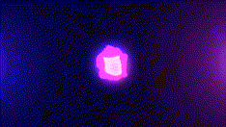
Beat Attack
Nime Midterm Presentation by Astou Diedhiou

Slide 2
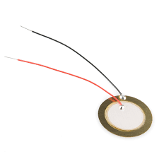
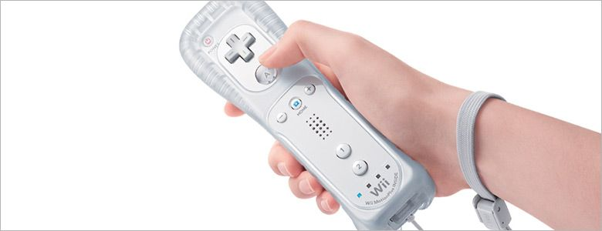
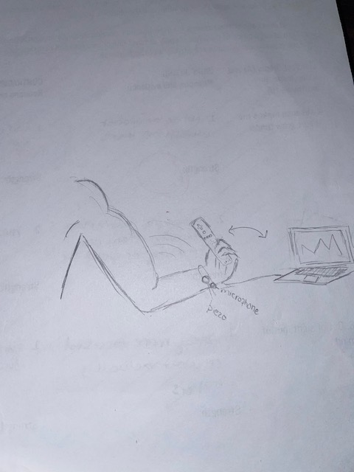
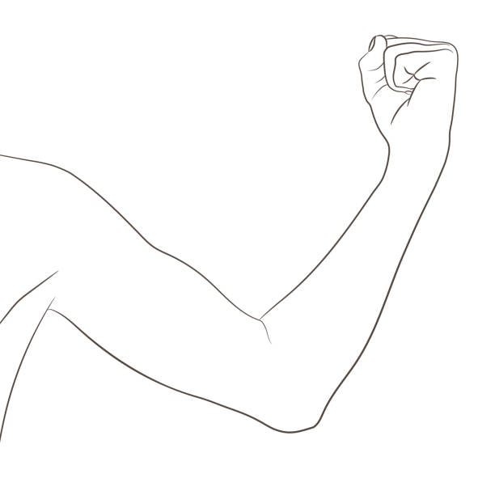
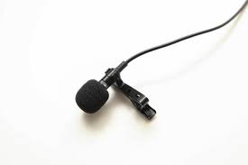
Design Of Nime

Slide 3
Description of Drumbeat
Hardware
Piezo Microphone attached taped to pulse
The sound of my pulse will be incorporated in the beat of the drum and how fast or slow I flex my arm over
The Gesture that will influence the sound is the flexing of my right arm moving back and forth with the Wii remote in hand
The faster you go the louder the drum will sound
The slower you go the quieter the drum will sound

Slide 4
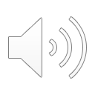
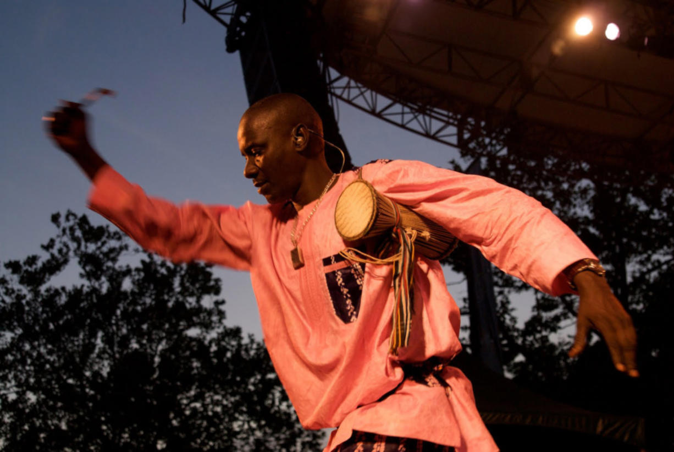
Description Continued
The Wii remote contributes to triggering a drum sound in the software
The idea of the hand gestures comes from my idea of seeing many drummers in my culture use smaller drums and flexing the arm repeatedly to hit it

Slide 5
Software
Maxspatch Software
Using the hand gesture, I will be able to connect my computer to this specific gesture which will then trigger a drum beat through maxspatch
The programming will allow the speed of the gestures to replicate the drum beat

Slide 6
Creation of Nime
With the creation of this Nime, I plan on using as many resources as possible to make it usable and to represent the drum beat that I had originally thought of
Making sure that time and accuracy is put into the Nime

